Slide 1


KORPSoft EKYC Web and Backoffice Process
Introduction
Pre-requisites for EKYC
EKYC Process
EKYC Backoffice Process

Slide 2
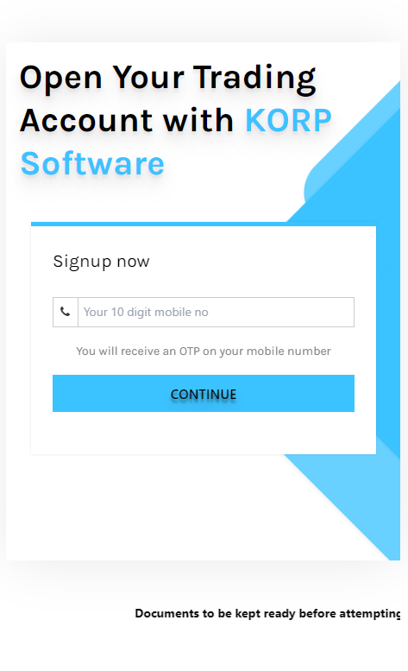
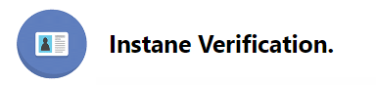

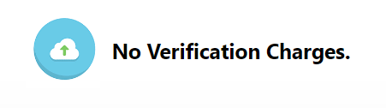

About EKYC
KORP Soft provides new investors to complete the KYC process digitally with OTP bases Aadhaar authentication without any hassles.
The EKYC through Aadhaar authentication service allows investors to make investments in desired mutual funds with minimal efforts and without any limits or restrictions.

Slide 3
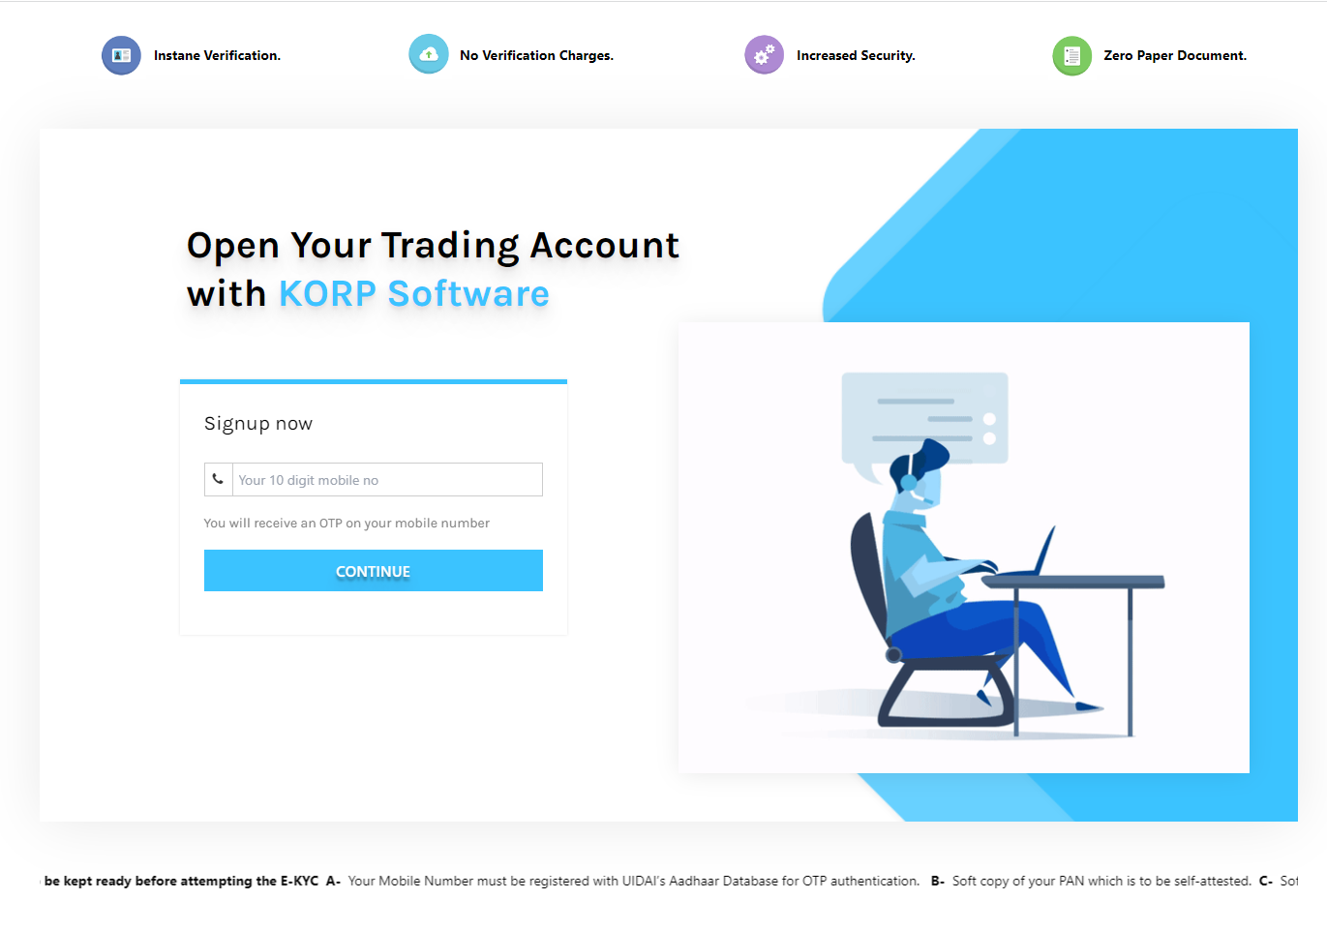
Pre-requisites for EKYC
NSDL PAN Services : NSDL services for online PAN Verification. For more detail go to https://www.incometax.gov.in/iec/foportal/
Digio Services for EKYC : DigiKYC allows user to implement KYC processes through built-in Aadhaar Offline XML KYC, built-in DigiLocker integration, ID Card parsing and analysis, and Video IPV (V-CIP). For more details go to https://www.digio.in/#/index
Digio Penny Drop Services for Bank Verification : Penny drop verification is a form of bank account validation in which a penny, usually INR 1 (hence, the name), is deposited into the bank account. More details visit : https://www.digio.in/#/index
Digio Services for Esign : Through the interface provided by Digio, users can electronically/digitally sign any electronic content by Aadhaar eSign. More details visit : https://www.digio.in/#/index
RazorPay Services: Accept payments from customers. You can get account opening charges through RazorPay Api. (Not require if you do not charge any fee for account open.). For more details visit : https://razorpay.com/

Slide 4
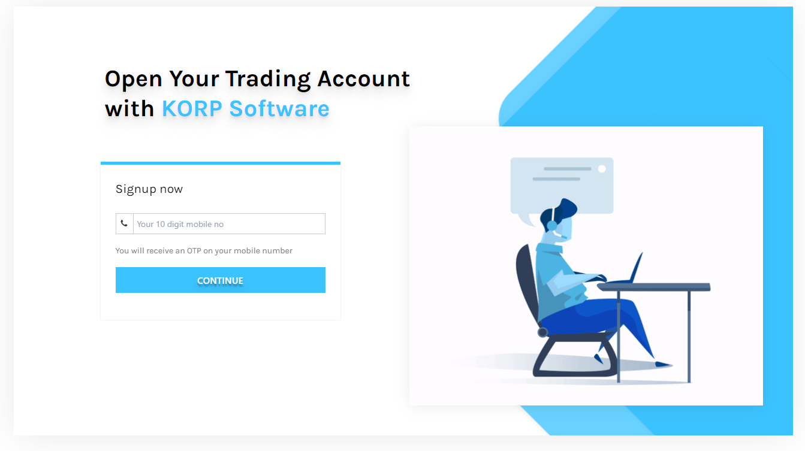
EKYC Process
Step 1. Enter mobile no. and click on continue(Investor need an Aadhaar linked mobile number to open an account online).

Slide 5
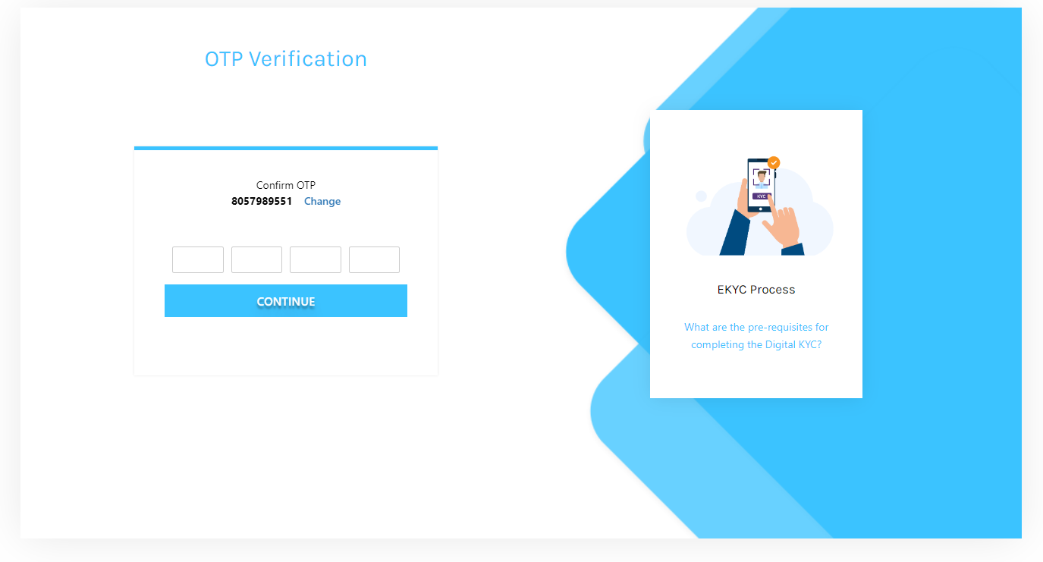
Step 2. Enter the 4-digit OTP received on your mobile phone and click on continue.

Slide 6
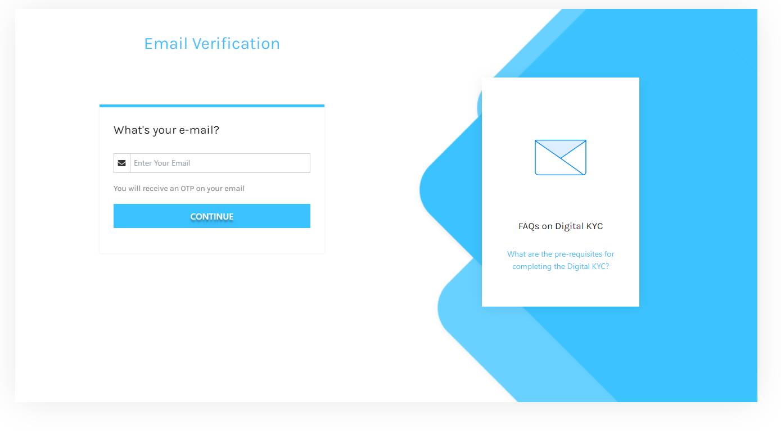
Step 3. Enter Email Id. and click on continue.

Slide 7
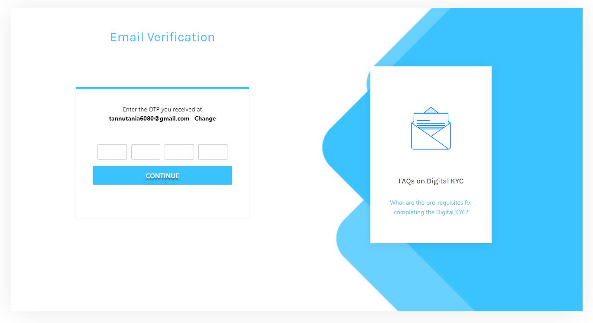
Step 4. Enter 4-digit OTP received on your email id.

Slide 8
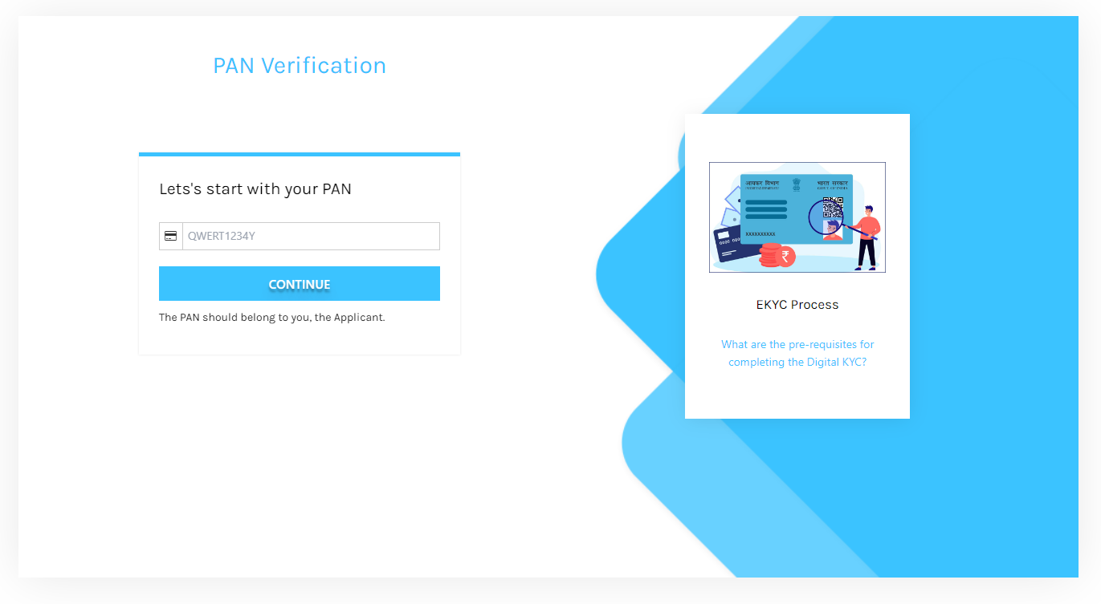
Step 5. Enter Your PAN.

Slide 9
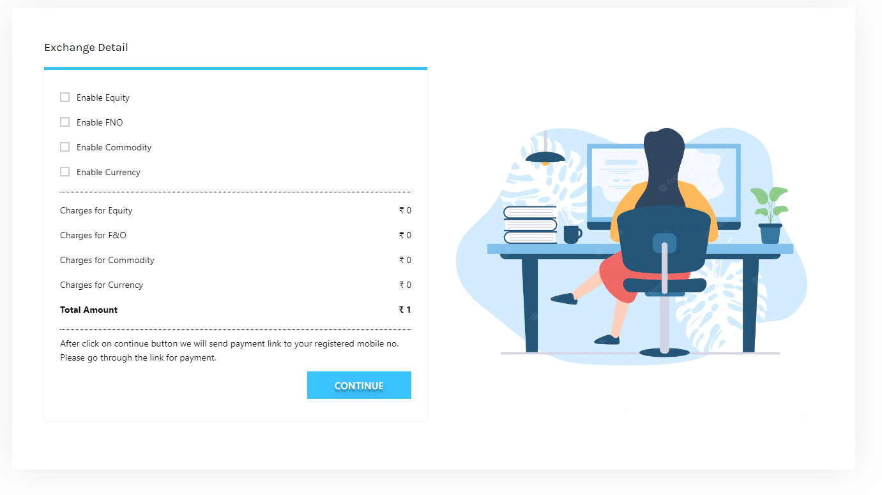
Step 6. Select your Exchange/Segment Detail and pay account opening fees using UPI or through Net banking. Client receive a payment link on his registered mobile no.

Slide 10
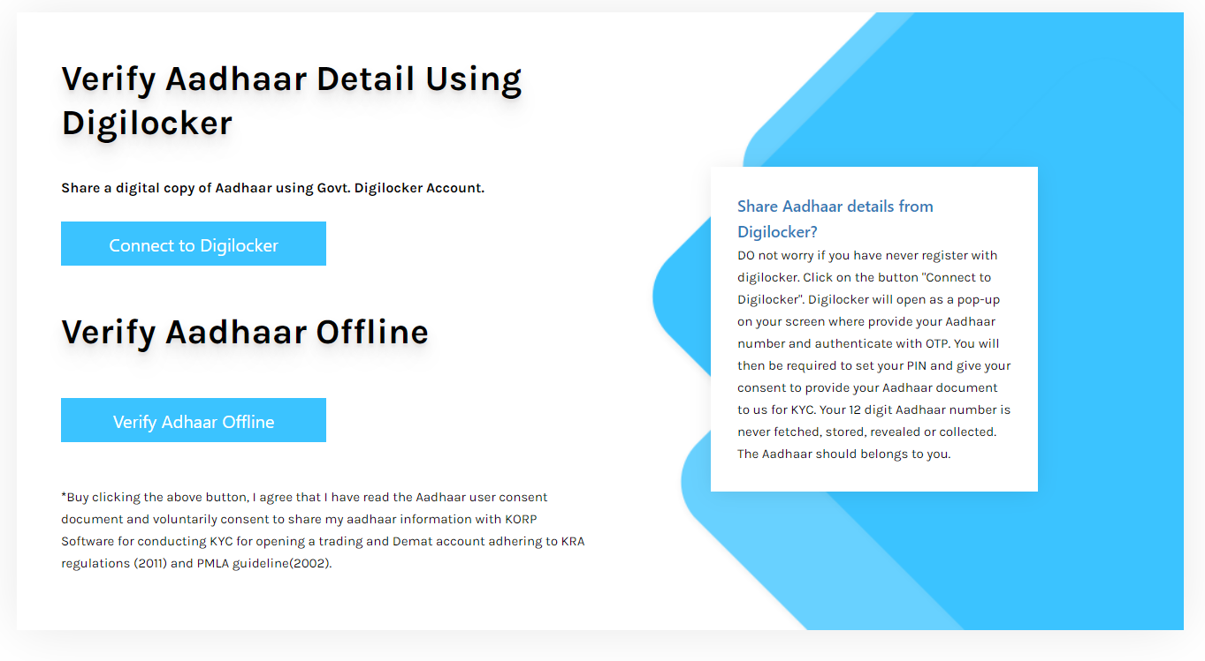
Step 7. Verify Aadhaar offline/Online.

Slide 11
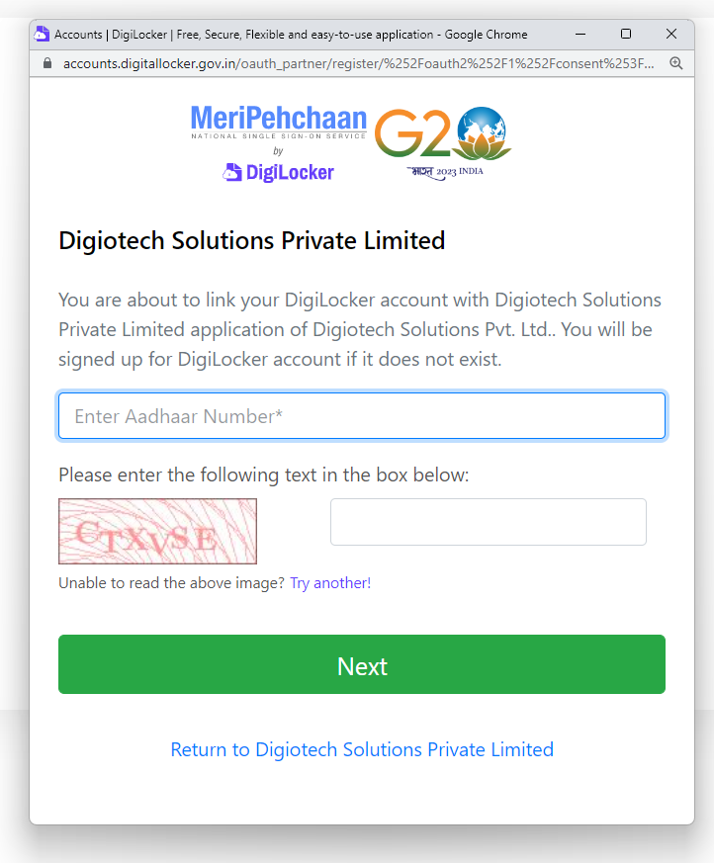
Online Aadhaar Verification: Sign in to your Digilocker account to share your Aadhar details.

Slide 12
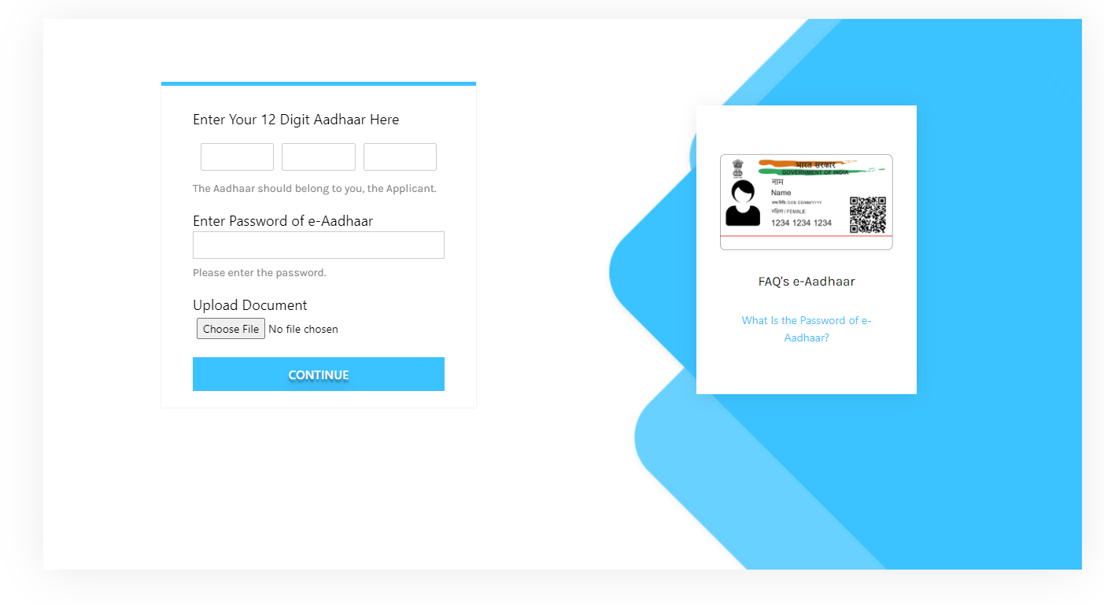
Offline Aadhaar Verification: Enter your Aadhaar no, Go to URL https://resident.uidai.gov.in/offlineaadhaar.
Download zip file of your Aadhaar with password.
Enter password and upload zip file on upload document input.

Slide 13
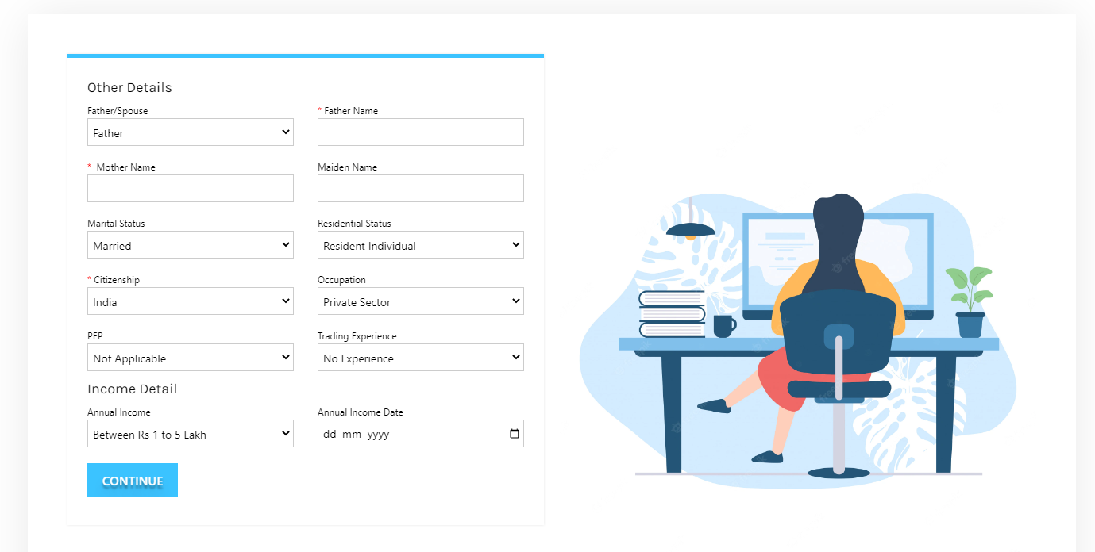
Step 8. Insert Other Details and click on continue.

Slide 14
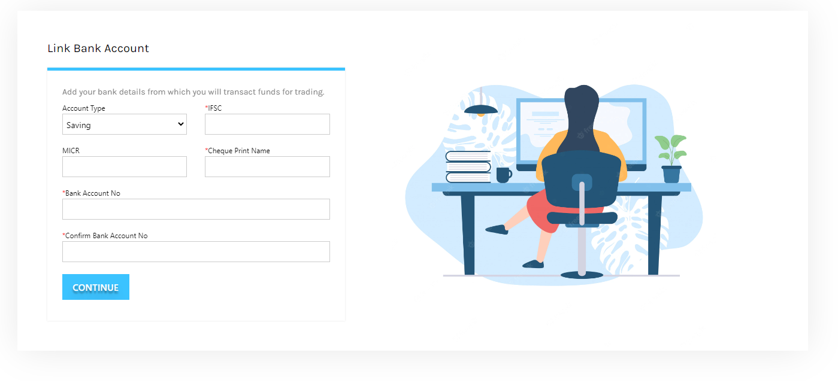
Step 9. Enter your bank account details and background information. (Bank details verify through penny drop services.)

Slide 15

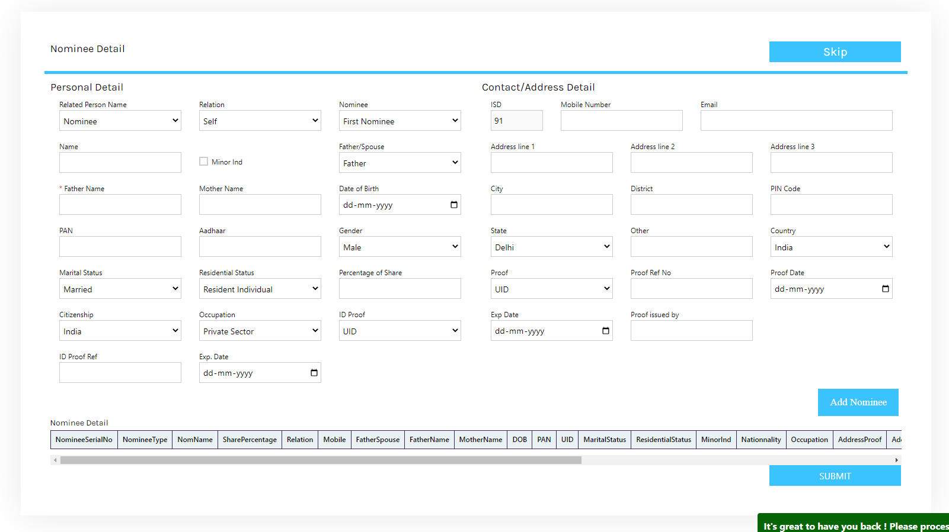
Step 10. Add Nominee Detail. Skip if you don’t want to add Nominee.

Slide 16
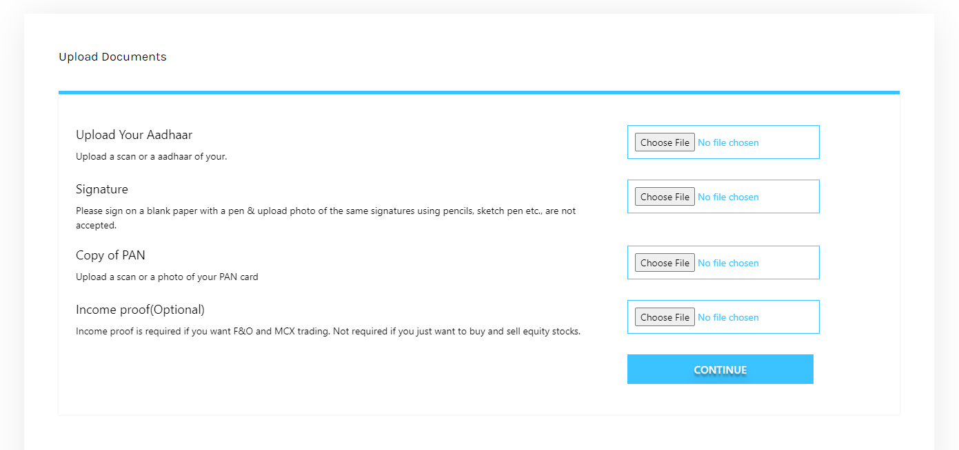
Step 11. Upload all the required documents like PAN, Aadhar card, canceled cheque, signature photo proof, and Income proof (mandatory only for derivatives trading).

Slide 17
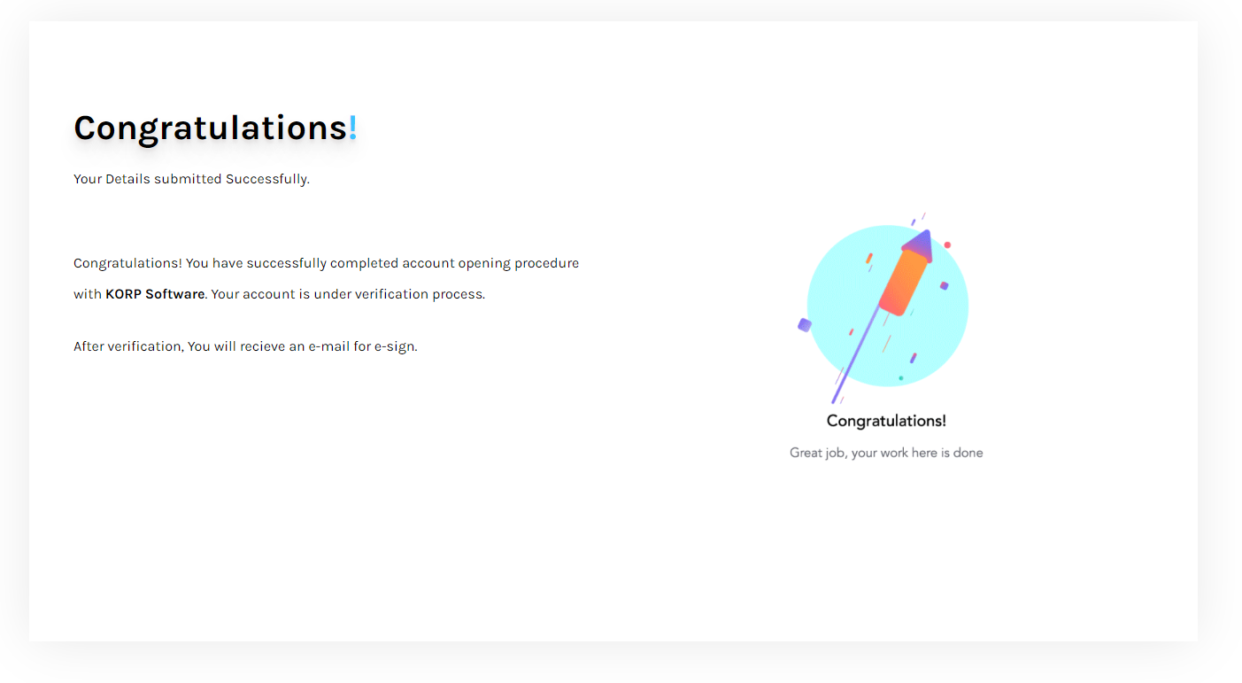
Completed. After E-KYC, All the application submitted on your web EKYC portal are directly fetch to your Backoffice software.

